Slide 1

WEB
TECHNOLOGY
UTTAM K. ROY
Dept. of Information Technology,
Jadavpur University, Kolkata

Slide 2
Agenda
Background
HTTP Protocol
Domain Name System (DNS)
Simple Mail Transfer Protocol (SMTP)
HyperText Markup Language(HTML)
JavaScript
XML
JSP

Slide 3
Background

Slide 4
WWW
World Wide Web—a repository of information
Introduced in 1991
Originated from the CERN High-Energy Physics laboratory in Geneva, Switzerland.
Purpose—create a system to handle distributed resource
A client-server service
Service provider—called website

Slide 5
The Web: Some Jargon
Web page
  consists of objects (HTML file, JPEG image, GIF image…)
  addressed by URL
Most Web pages consist of
  base HTML page
  several referenced objects—Hypertext and Hepermedia
URL
  A standard way of specifying the location of an object, typically a web page, on the Internet
User agent for Web is called a browser
  MS Internet Explorer
  Opera
  Netscape Navigator
  Mozzila
  Konquor
  Google Crome
Server for Web is called a Web server

Slide 6
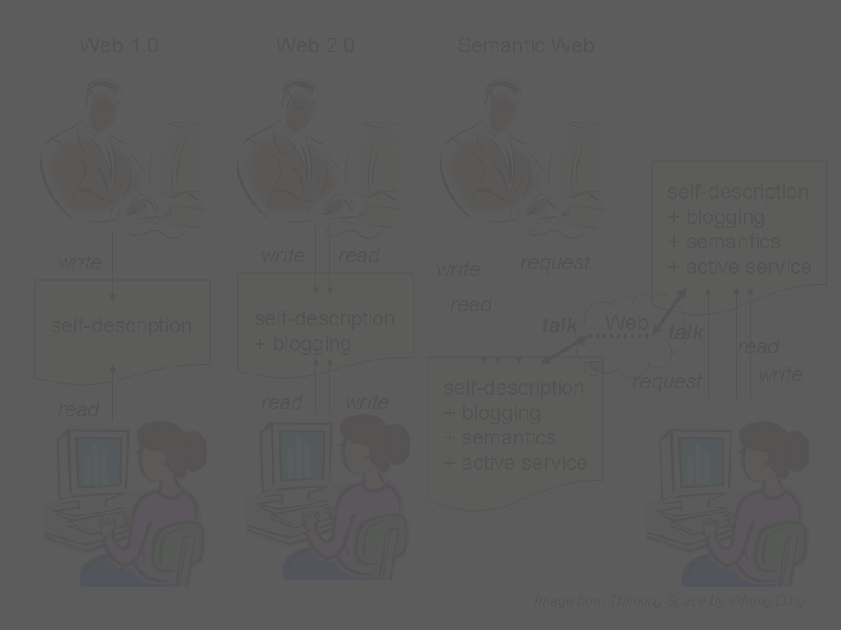
HyperText Transfer Protocol (HTTP)

Slide 7
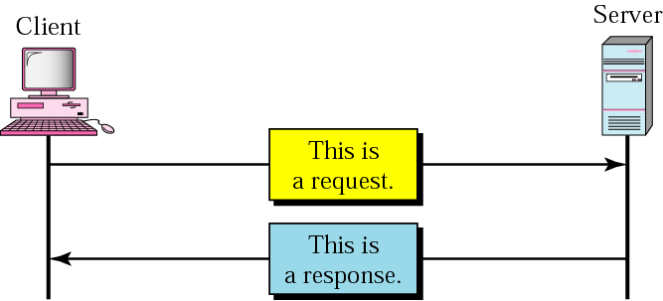
HyperText Transfer Protocol
Web’s application layer protocol
  Used to access data on the World Wide Web
  Rapid jump from one document to another
Client-server model
  client: browser that requests, receives, “displays” web objects
  server: Web server sends objects in response to request
uses TCP connection on the well-known port 80

Slide 8
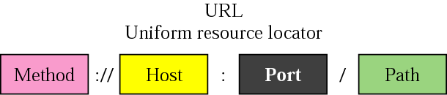
URL
An address of the web page or other information on the Internet
Example
  http://www.yahoo.com/
  http://www.jusl.ac.in/images/sitemap.gif
  http://www.foldoc.org/?Uniform+Resource+Locator
  http://mail.jusl.ac.in/
  http://www.it.site.jusl.ac.in:8081/jsp/test.jsp
  ftp://wuarchive.wustl.edu/mirrors/msdos/graphics/gifkit.zip

Slide 9
URL - continued
Method
  protocol used to retrieve the document (FTP, HTTP, …)
Host
  a computer where the info is located
  the name/IP address of the computer; can be an alias (not necessary www)
Port
  optional port # of the server (default is 80)
Path
  the path name of the file where the info is located

Slide 10
HTTP - example
Suppose user enters URL www.yahoo.com/index.html
1. http server is created at port 80 which waits for TCP connection to be established by the clients
2a. http client initiates TCP connection to http server (process) at www.yahoo.com. Port 80 is the default for http server
2b. http server at host www.yahoo.com waiting for TCP connection at port 80 “accepts” connection, notifying client
3. http client sends http request message (containing URL) into TCP connection socket
4. http server receives request message, forms response message containing requested object (index.html), sends message into socket
time

Slide 11
HTTP – example (cnt’d)
5. http server closes TCP connection
6. http client receives response message containing html file, parses html file (using browser), finds embedded image, and finally displays in the browser
7. steps 1-5 repeated for another resource
time

Slide 12
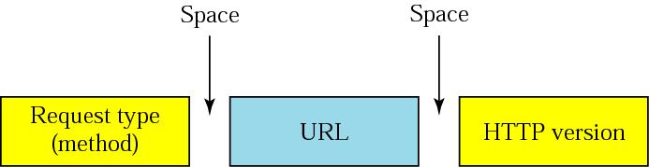
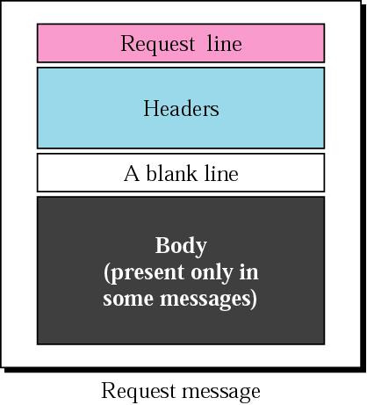
HTTP protocol – message format
two types of messages: request & response
HTTP request message
HTTP/0.9 HTTP/1.0 HTTP/1.1
GET – when the client wants to retrieve a document from the server
HEAD – when the client wants some info about a document but not document itself
COPY – copies the file to another location

Slide 13
Other Request type (method)
Method | Description
POST | Used to provide information (e.g. input) to the server
PUT | Used to provide a new or replacement document to be stored on the server
PATCH | Similar to PUT except that the request contains only list of differences that should be implemented in the existing file
MOVE | Used to copy a file to another location
DELETE | Used to remove a document from the server
LINK | Used to create a link or links of a document to another location
UNLINK | Used to delete link created by LINK
OPTION | Used by the client to ask the server about available options

Slide 14
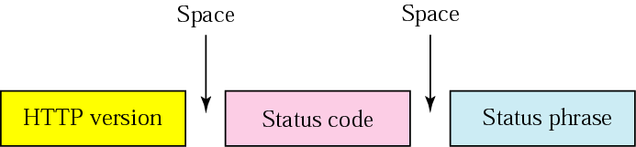
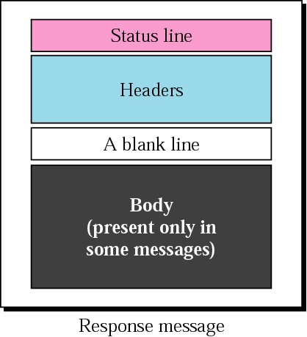
HTTP – message format
HTTP response message
http://www.w3.org/Protocols/HTTP/HTRESP.html
explains the status code
in text form
200 OK – request succeeded
301 Moved Permanently – object moved
400 Bad Request – not understood by server
404 Not Found – req. document not found

Slide 15
HTTP – message format (Status code)
100 range | Informational
200 range | Successful request
300 range | Redirectional
400 range | Client Error
500 range | Server Error

Slide 16
HTTP – message format (Status code)
Code | Phrase | Description
Informational
100 | Continue | The initial part of the request has been received and the client may continue with its request
101 | Switching | The server is complying with a client request to switch protocols defined in the upgrade header
Success
200 | OK | The request is successful
201 | Created | A new URL is created
202 | Accepted | The request is accepted, but it is not immediately acted upon
204 | No content | There is no content in the body
Redirection
301 | Multiple choices | The requested URL refers to more than one request
302 | Moved permanently | The requested URL is no longer used by the server
304 | Moved temporarily | The requested URL has moved temporarily

Slide 17
HTTP – message format (Status code)
Code | Phrase | Description
Client Error
400 | Bad Request |  | There is a syntax error in the request
401 | Unauthorized |  | The request lacks proper authorization
403 | Forbidden |  | Service is denied
404 | Not found |  | The document is not found
405 | Method not allowed |  | The method is not supported in this URL
406 | Not acceptable |  | The format request is not acceptable
Server Error
500 | Internal Server Error | There is an error, such as crash, the server side
501 | Not Implemented | The action requested can not be performed
503 | Service unavailable | The service is temporarily unavailable, but may be requested in the future

Slide 18
HTTP – message format
HTTP response message

Slide 19
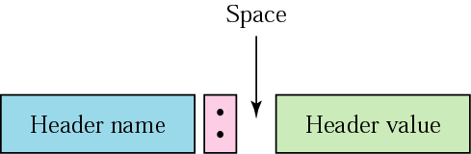
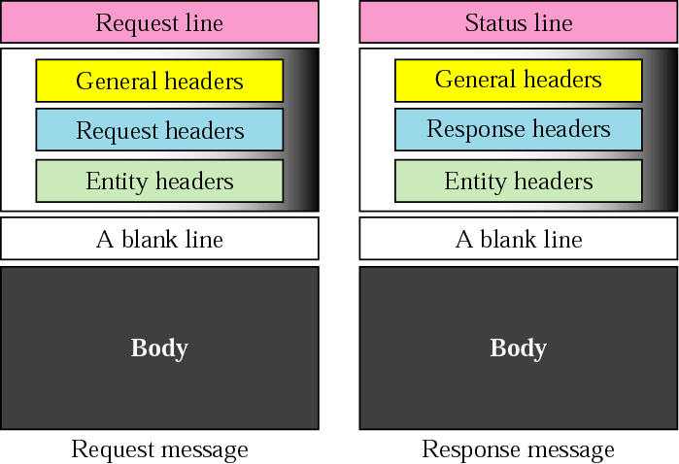
HTTP – message format
Headers
  exchange additional information between the client & the server
  example
    Date
    Client’s email address
    Document age
    Content length

Slide 20
HTTP – message format
General Header
Header | Description
Cache-control | Specifies information about caching
Connection | Shows whether the connection should be closed or not
Date | Shows the current date
MIME-version | Shows the MIME version used
Upgrade | Specifies the preferred communication protocol

Slide 21
HTTP – message format (Request Header)
Header | Description
Accept | Shows media format the client can accept
Accept-charset | Shows the character set the client can handle
Accept-encoding | Shows the encoding scheme the client can handle
Accept-language | Shows the language the client can accept
Authorization | Shows the permission the client has
From | Shows the email address of the user
Host | Shows the host and port number of the client
If-modified-since | Send the document if newer than specified date
If-match | Send the document only if matches given tag
If-non-match | Send the document only if does not match given tag
If-range | Send only the portion of the document that is missing
If-unmodified-since | Send the document if not changed since specified date
Referrer | Specifies the URL of the linked document
User-agent | Identifies the client program

Slide 22
HTTP – message format (Response Header)
Specifies the server’s configuration and special information about the request
Header | Description
Server | Shows the server name and version number
Age | Shows the age of the document
Public | Shows the supported list of methods
Retry-after | Specifies the date after which the server will be available
Accept-range | Shows if server accepts the range requested by client

Slide 23
HTTP – message format (Entity Header)
Specifies information about the body
Header | Description
Allow | List of valid methods that can be used with a URL
Content-encoding | Specifies the encoding scheme
Content-language | Specifies the language
Content-length | Shows the length of the document
Content-range | Specifies the range of the document
Content-type | Specifies the media type
Etag | Gives an entity tag
Expires | Gives the date and time when contents may change
Last-modified | Gives the date and time of the last change
Location | Specifies the location of the created of moved document

Slide 24
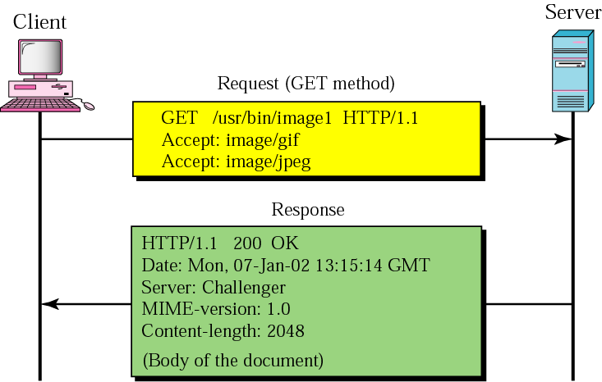
HTTP messages – an example
This example retrieves a document.
We use the GET method to retrieve an image with the path /usr/bin/image1.
The request line shows the method (GET), the URL, and the HTTP version (1.1).
The header has two lines that show that the client can accept images in GIF and JPEG format.

Slide 25
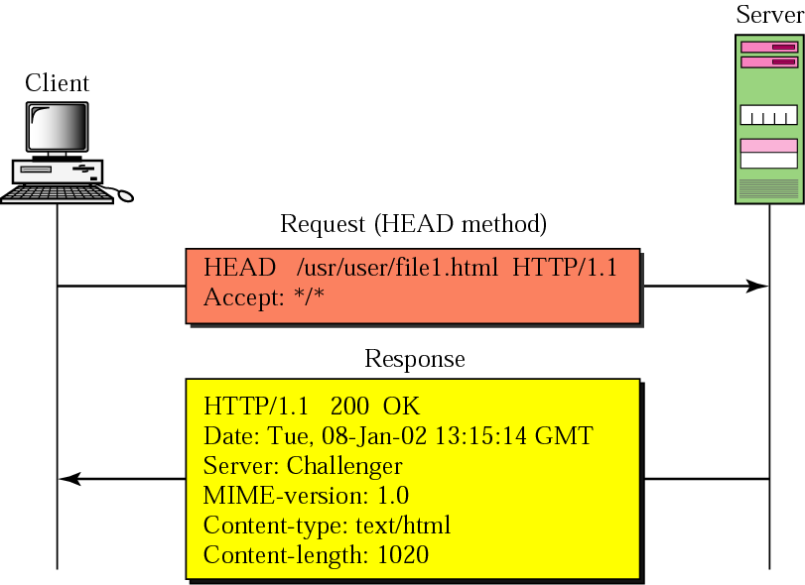
HTTP messages – an example
This example retrieves information about a document. We use the HEAD method to retrieve information about an HTML document

Slide 26
Persistent and nonpersistent connections
Nonpersistent
  HTTP 1.0
  one TCP connection for each request/response
  the client opens a TCP connection and sends a request
  the server sends the response and closes the connection
  the client reads data and closes the connection
  each object transfer is independent
Persistent
  default for HTTP 1.1
  the server leaves the TCP connection open for more requests after sending a response
  client sends requests for all referenced objects as soon as it receives base HTML
    pipelining
  fewer RTT

Slide 27
Web caches - Proxy
HTTP supports Proxy servers
Proxy server
  a computer that keeps copies of responses to recent requests
Goal: satisfy client request without involving original server
Origin server
client sends all http requests to the proxy server
if object at web cache, sends the object in http response
else request object from the origin server, then returns http response to client
http response
Proxy server
client
http request
http response
http request
client
Origin server

Slide 28
Why Web caching?
Assume: cache is closed to a client (in the same network)
  smaller response time (improved latency)
  decrease traffic to distance servers
    link out of ISP network is often a bottleneck
the Internet
1.544 Mbps link
institutional network
10 Mbps LAN
institutional cache

Slide 29
Consistency of Web caching
The major issue: How to maintain consistency?
Two ways:
  Pull
    Web caches periodically pull the web server to see if a document is modified
  Push
    Whenever a server gives a copy of a web page to a web cache, they sign a lease with an expiration time; if the web page is modified before the lease, the server notifies the cache

Slide 30
Domain Name System
(DNS)

Slide 31
Domain Name System (DNS)
IP uses 32-bit address
  Problem: difficult to remember
  Solution: use names instead of IP addresses
  Problem: IP does not understand name
  Solution: Map a name to an IP address & vice-versa
  example:
    www.yahoo.com → 87.248.112.181
    www.google.com →173.194.66.147
    www.uroy.biz → 5.9.126.141
    www.it.site.jusl.ac.in → 203.197.107.107

Slide 32
Domain Name System (DNS)
Possible solution:
  a host file, two columns: name & address
  Every host stores this file
  Update periodically from master file
Problems:
  Host file would be too large to store
  Update problem
  Solution
    Store this host file centrally
    Problem: Huge amount of traffic

Slide 33
Domain Name System (DNS)
Solution for huge amount of information:
  divide it into smaller parts and store each part on different computer—called DNS Server
  Host needs name resolution, contacts nearest DNS Server
  if one DNS server doesn't know how to translate a particular domain name, it asks another one, and so on, until the correct IP address is obtained.

Slide 34
Domain Name System (DNS)
Name space
  flat name space
    Centrally controlled to avoid ambiguity and duplication
      cannot be used in larger networks like the Internet
  hierarchical name space
    each name is made of several parts
    central authority only partially control names (www.jadavpur.edu)
      www.it.site.jusl.ac.in
      www.cse.iitk.ac.in
      www.google.com
      www.ieee.org

Slide 35
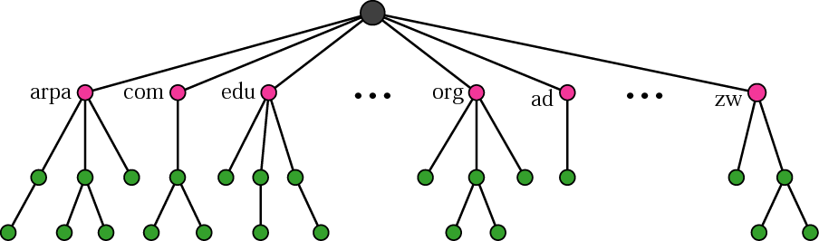
Domain Name Space
designed to have a hierarchical name space
tree structure (maximum 128 levels)
label
all labels (maximum of 63 characters) have different names
  uniqueness of the domain names
root label - null

Slide 36
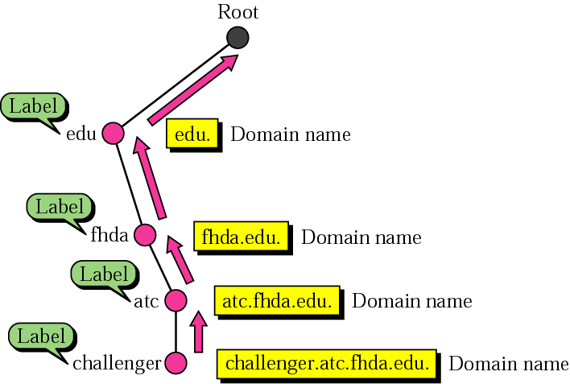
Domain name
Every node has a domain name
Domain name – a sequence of labels separated by dots
read from the node up to the root
full domain name ends with the null
Fully qualified domain name
  challenger.atc.fhda.edu.
Partially qualified domain name
  challenger

Slide 37
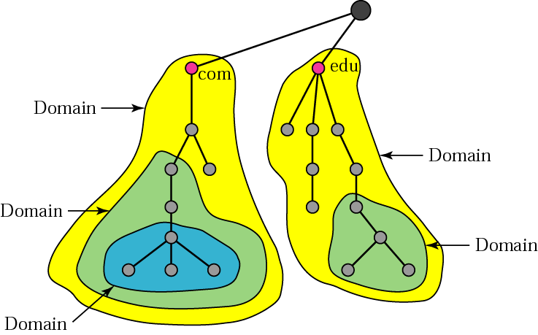
Domain
A sub-tree of the Domain Name Space
Name of a domain is the domain name of the node at the root of the subtree
Sub-domain—a part of larger domain

Slide 38
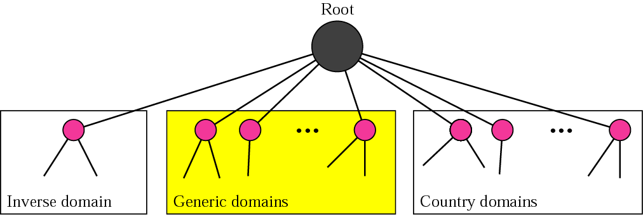
DNS in the Internet
Generic domains
  registered host according to their generic behavior
Inverse domain
  used to map an address to a name
Country domains
  the same format as in generic domain just 2 character format
    us; nl; jp; fr; in

Slide 39
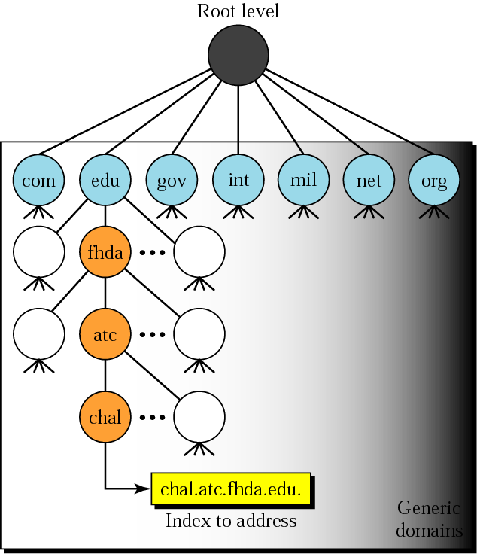
Generic domain
Label | Description
com | Commercial organizations
edu | Educational institutions
gov | Government institutions
int | International organizations
mil | Military groups
net | Network support centers
org | Nonprofit organizations
aero | Airlines and aerospace companies
biz | Businesses or firms (similar to ‘com’)
coop | Cooperative business organizations
info | Information service providers
museum | Museums and other nonprofit organizations
name | Personal names (individuals)
pro | Professional individual organizations

Slide 40
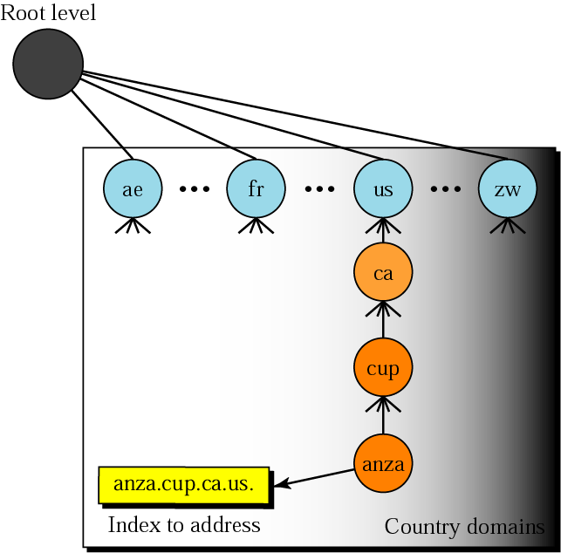
Country domains

Slide 41
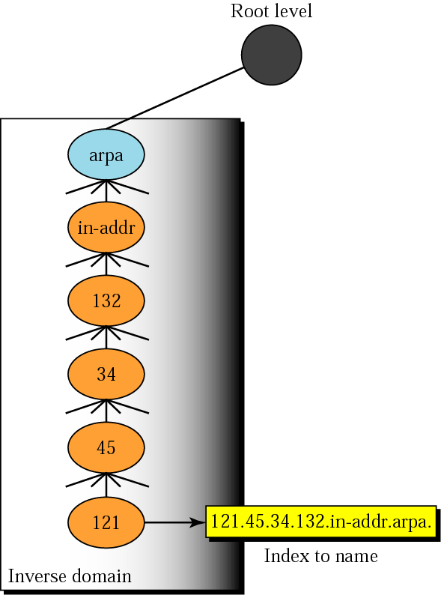
Inverse domain
Example: a server wishes to determine whether the client is on the authorized list
First-level node arpa for historical reasons
The servers are also hierarchical
Domain looks inverted compared to a generic or country domain

Slide 42
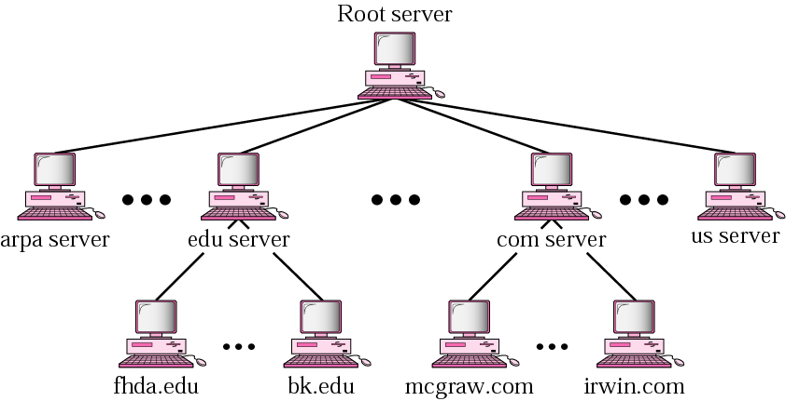
Distribution of name space
Storing all naming information in one computer is
  unreliable
  inefficient
    Responding to requests from all over the world places a heavy load on the system
Hierarchy of Name Servers

Slide 43
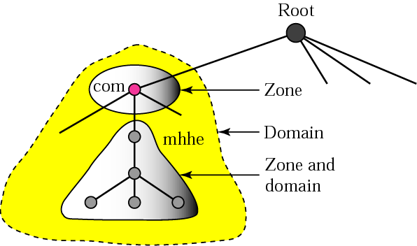
DNS zones, servers -
original server keeps a sort of a reference to the lower-level servers
Root servers
  13 in the world
Primary server
  loads the information about the the zone from the disk
Secondary server
  loads the info from the primary server
    redundancy against failure

Slide 44
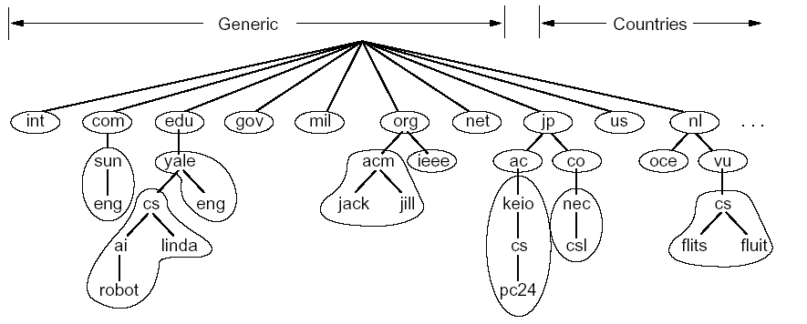
Zones (cnt’d)
separate name server

Slide 45
Resolution
Mapping a name to an address or vice-versa
Resolver
  DNS client
  When a host needs to map an address to a name it calls resolver that in turn access the nearest DNS server with a mapping request
  A server either
    responds directly with an info, or
    refers the resolver to other servers
    asks other servers to provide info
Recursive resolution
Iterative resolution

Slide 46
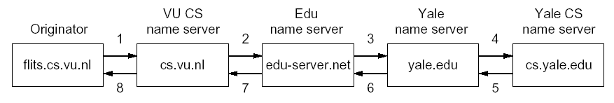
Recursive resolution
flits.cs.vu.nl -> linda.cs.yale.edu
if the server is the authority for the domain name it checks its data base and responds, otherwise
it sends a request to another server…

Slide 47
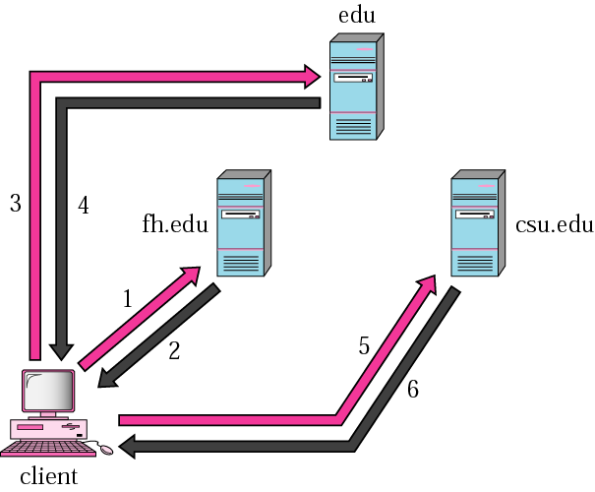
Iterative resolution
The server returns either IP requested address or the IP address of the server it thinks can resolve the query
edu-derver.net
yale.edu
cs.vu.nl

Slide 48
Dynamic DNS
What if a new host joins the network or a host is removed or an IP address is changed?
DNS master file also has to be changed
Changes so dynamic – a problem!
Dynamic Domain Name System
When a binding between IP address & host name is determined (usually) DHCP informs DNS server
Encapsulation
  DNS can use either UDP or TCP, using the well-known port 53

Slide 49
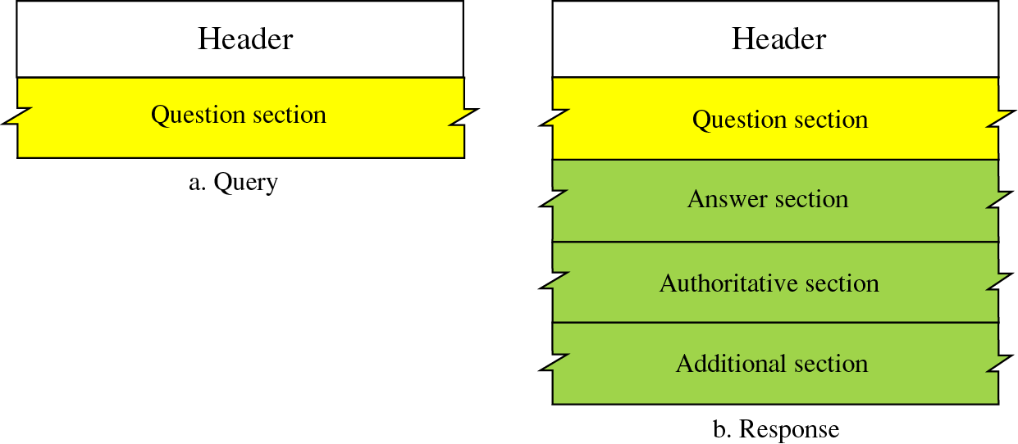
DNS Mesaages
Messages
Query
Response

Slide 50
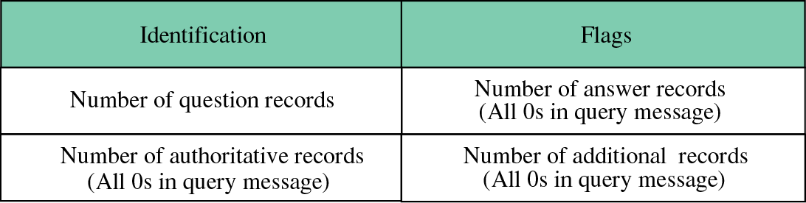
Header Format
Identification
  16-bit field used by the client to match response with the query

Slide 51
Flag Fields
QR: Query/Response
OpCode: 0 standard, 1 inverse, 2 server status
AA: Authoritative
TC: Truncated
RD: Recursion Desired
RA: Recursion Available
rCode: Status of the error

Slide 52
Resource Records
Five tupple in the form
  Domain_name Time_to_live Type Class Value
Type
Meaning
Value
SOA
Start of Authority
Parameters for this Zone
A
IP address of a host
32-bit Integer
MX
Mail Exchange
Priority, domain willing to accept mail
NS
Name Server
Name of a Server for this domain
CNAME
Canonical Name
Domain Name
PTR
Pointer
Alias for an IP address
HINFO
Host Description
CPU and OS in ASCII
TXT
Text
Uninterrupted ASCII text

Slide 53
Resource Records
$TTL 86400
@ IN SOA rose.itd.jusl.ac.in. rose.itd.jusl.ac.in. (
2006062101
3H
15M
1W
1D )
IN NS rose.itd.jusl.ac.in.
; IN NS galaxy.itd.jusl.ac.in.
IN MX 1 rose.itd.jusl.ac.in.
rose IN A 203.197.107.107
www IN CNAME rose.itd.jusl.ac.in.
mail IN CNAME rose
dns IN CNAME rose
gateway IN CNAME rose
hporacle IN A 172.16.6.97
lotus IN A 172.16.6.107
galaxy IN A 172.16.6.108
nfs IN CNAME lotus
dhcp IN CNAME lotus
nis IN CNAME lotus

Slide 54
Simple Mail Transfer Protocol(SMTP)

Slide 55
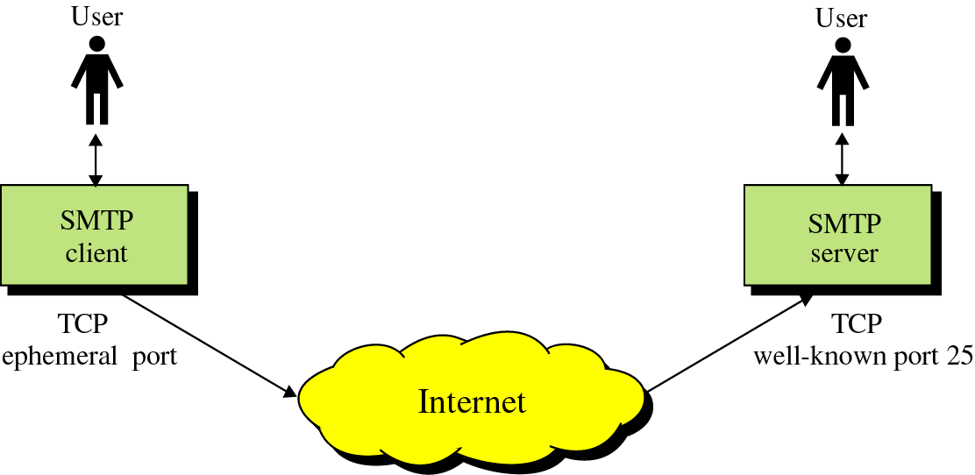
SMTP
Provides electronic mail(email) services using email addresses
  Sending a single message to one or more recipients
  Sending messages that include text, graphics, voice and video
Asynchronous service

Slide 56
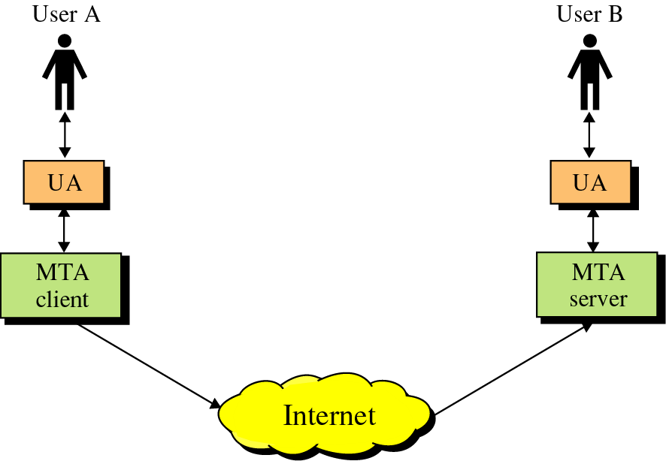
SMTP
SMTP Client/Server
  User Agent(UA)—prepares messages, creates envelop and put the message in the envelop
  Mail Transfer Agent(MTA)—transfers the mail across the Internet

Slide 57
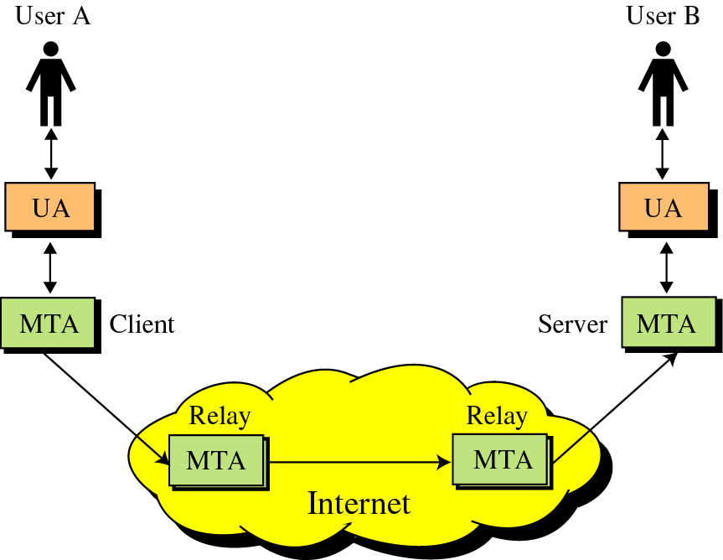
SMTP
Relay MTA—used to store mail in an intermediate stage

Slide 58
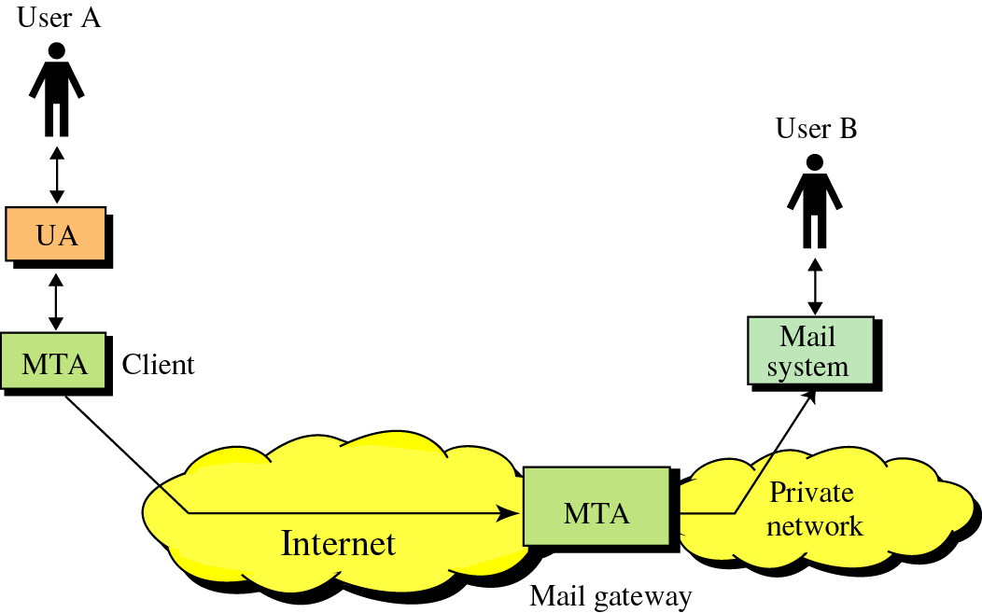
SMTP
Mail Gateway—used when either side does not use TCP/IP protocol

Slide 59
SMTP(User Agent)
Defined in SMTP without any implementation details
Normally a program that provides an interface to send and receive mails
Example
  Elm, Pine, MH, Berkley Mail, Zmail, Mush
  Eudora, Webmail etc.
Sending Mail
  Envelop
  Message
    Header
    Body
Receiving Mail
  UA checks mailbox periodically

Slide 60
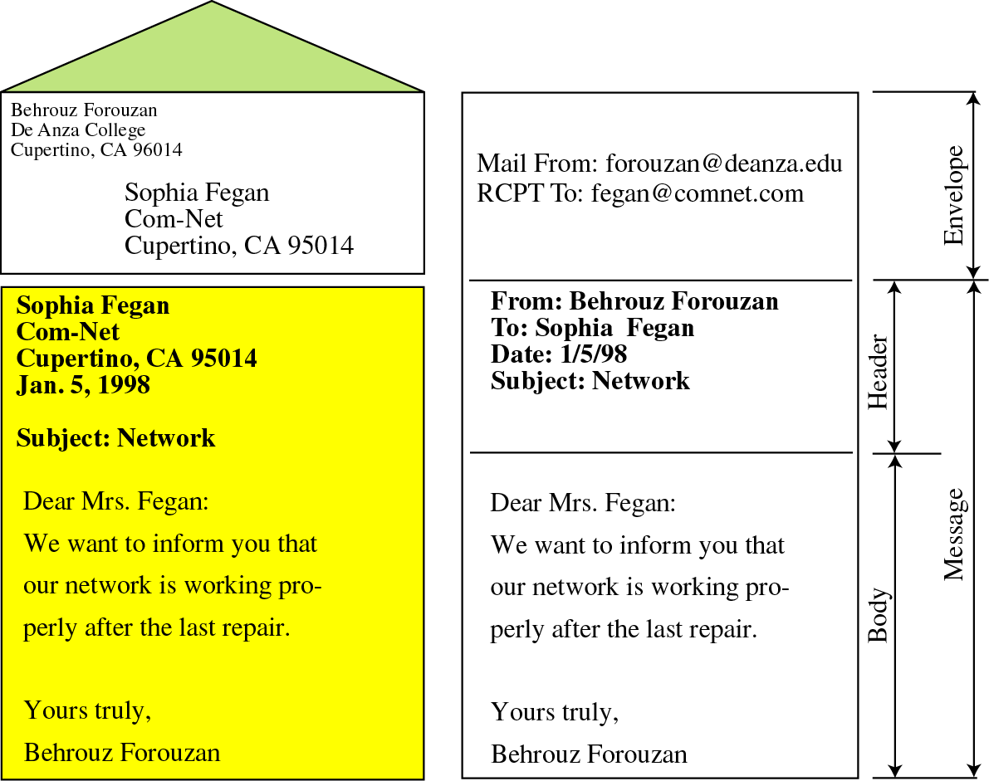
email format

Slide 61
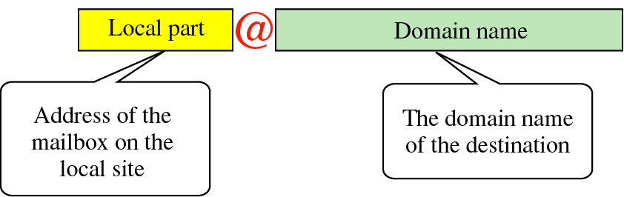
Addresses

Slide 62
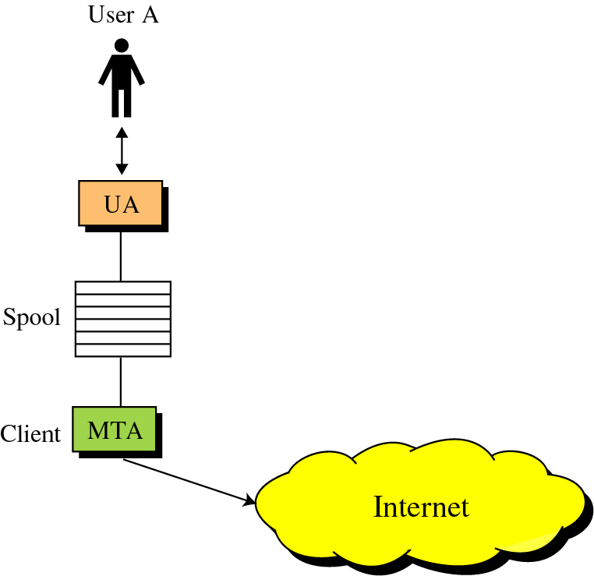
Delayed Delivery
Sender-site Delay
  Sender site stipulates a spooling system
  UA creates message and forwards it to Spooling system to store
  MTA checks spool periodically for new mail
  Delay depends upon following conditions
    IP address of the server is obtained through DNS
    Receiver is ready or not
  If the message can not be delivered, it is returned to the sender

Slide 63
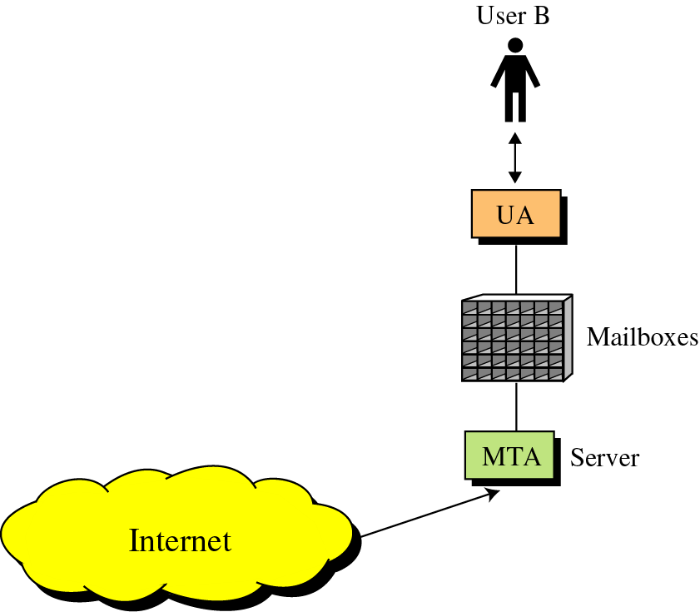
Delayed Delivery
Receiver-site Delay
  After receiving mail, it is stored in respective mailbox for reading
  Example
    Sendmail uses individual files to store mails
Intermediate Delay
  Mails can be stored by intermediate MTAs to send them when appropriate

Slide 64
Aliases
One-to-many Expansion
  Allows one name, called alias to represent several different email addresses
  A list of email addresses is associated with the alias using a database map
  If an alias is defined, mail destined to that name is sent to every recipient’s of the list
  If not defined, mail is sent to the user only

Slide 65
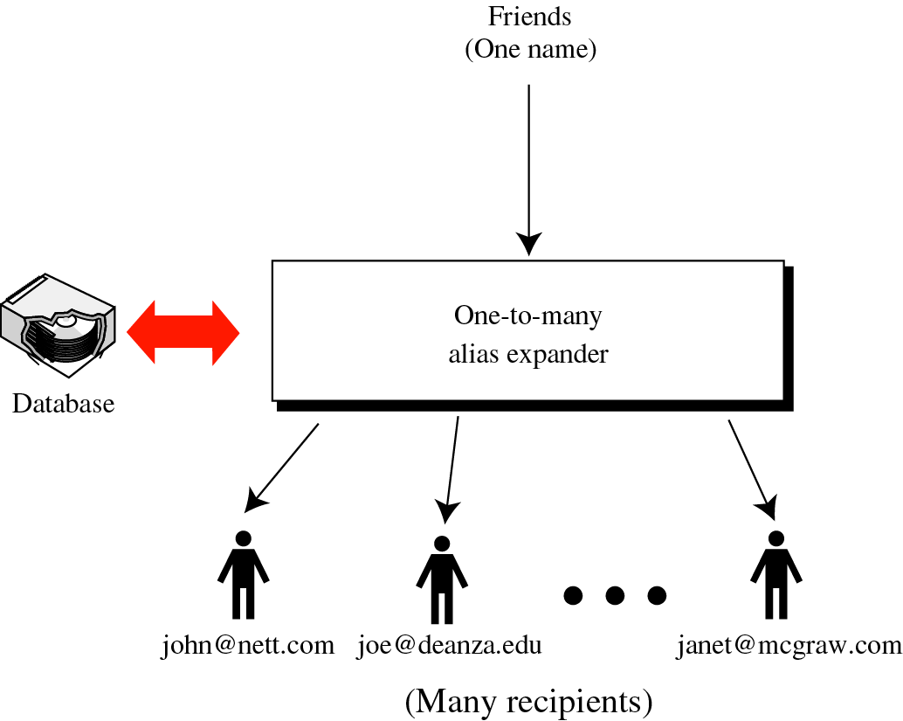
One-to-many expansion

Slide 66
Aliases
Many-to-one Expansion
  A user can have many different email addresses
  An alias database is used for this map
  Single mailbox is used
  Mails destined to all theses email addresses are sent to single user

Slide 67
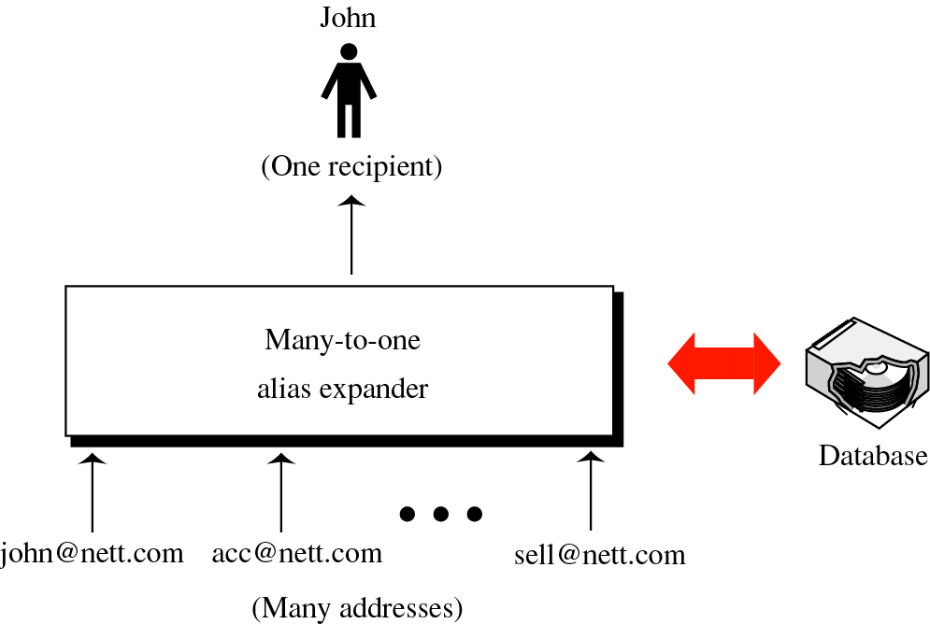
Many-to-one expansion

Slide 68
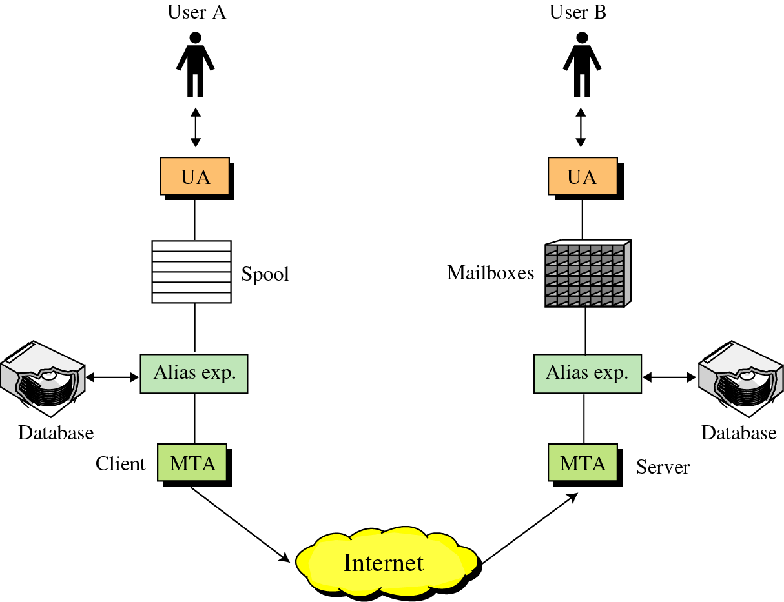
Aliases

Slide 69
Mail Transfer Agent(MTA)
Actual mail transfer is done through MTAs
  Client MTA is required to send mail
  Server MTA is required to receive mail
  Example
    Sendmail, squirlmail etc.

Slide 70
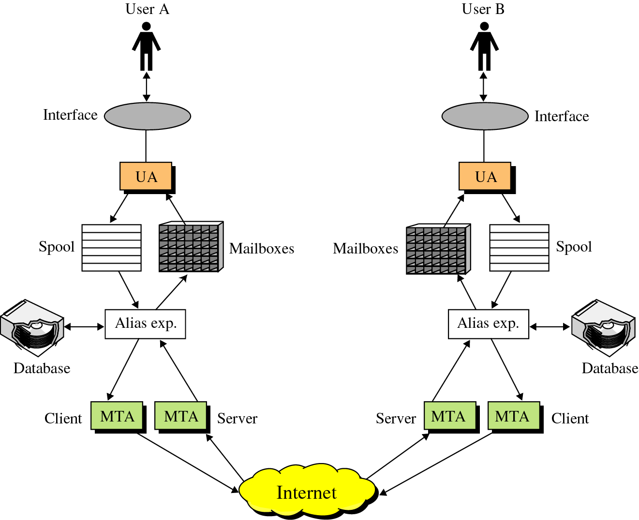
SMTP

Slide 71
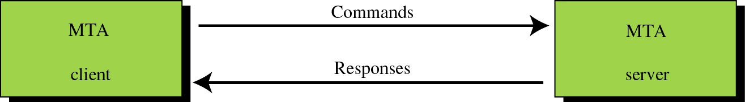
SMTP Messages
Messages
Commands
Responses

Slide 72
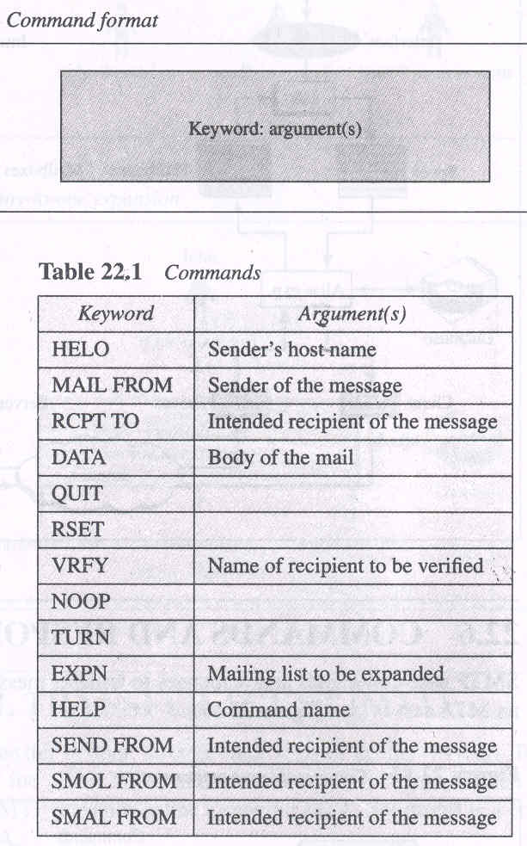
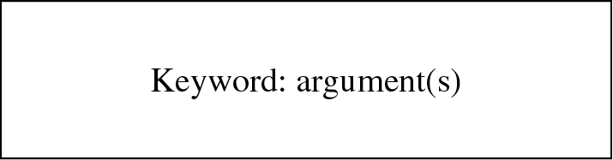
SMTP Messages(Commands)
Commands
  Commands are sent from client to server
  First five are mandatory

Slide 73
SMTP Messages(Responses)
Responses
  sent from server to client
  3 digit code of the following form
    2yz(positive completion)
      Requested command has been successfully completed and new commands can be started
    3yz(positive intermediate response)
      Requested command has been accepted, but recipient needs more information for completion
    4yz(transient negative completion reply)
      Command has been rejected, but error is temporary. The command can be sent again
    5yz(permanent negative completion reply)
      Command has been rejected permanently. The command can not be sent again during this session

Slide 74
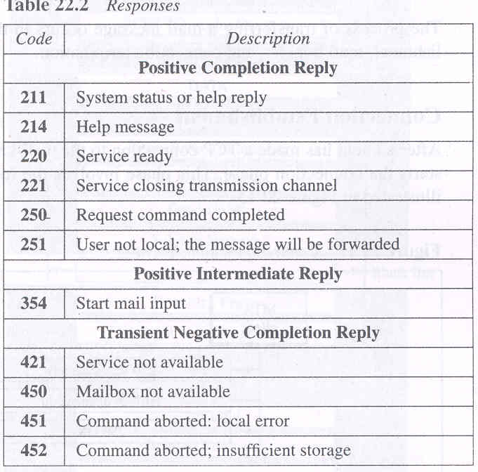
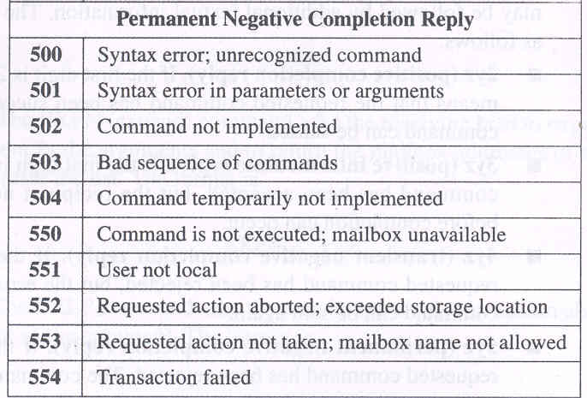
SMTP Messages(Responses)

Slide 75
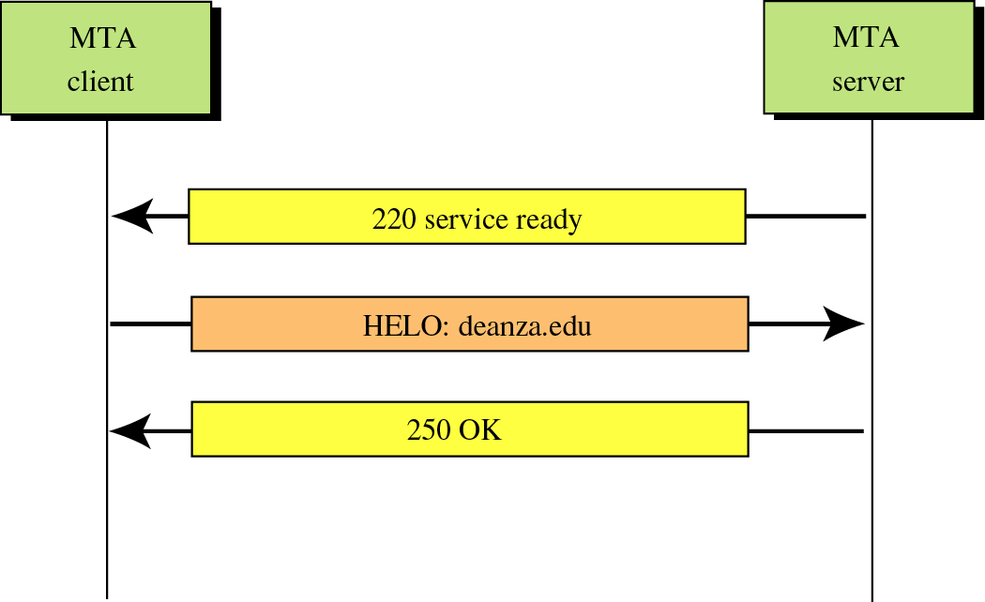
Figure 22-15
Connection establishment

Slide 76
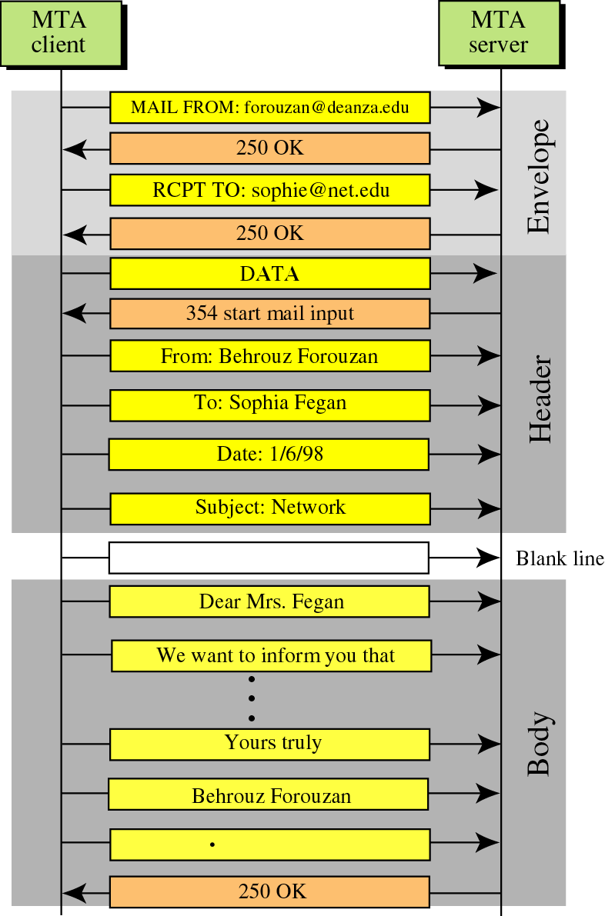
SMTP
An Example

Slide 77
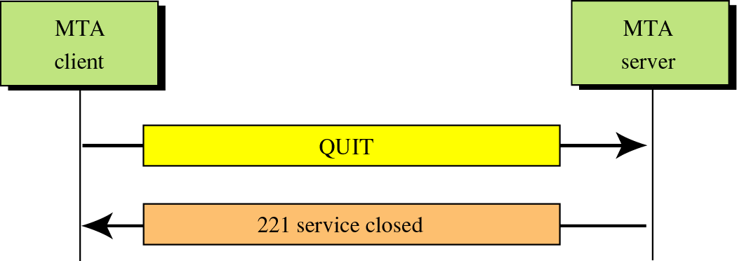
Connection Termination

Slide 78
MIME
SMTP uses 7-bit ASCII character set
  Can not be used for languages that are not supported by 7-bit ASCII characters. E.g French, German, Hebrew, Russian, Chinese, Japanese etc.
  Can not be used to send binary data or audio or video
MIME(Multipurpose Internet Mail Extension)
  A supplementary protocol that allows non-ASCII data to be sent through SMTP
  Can be thought of as software functions that transform non-ASCII to ASCII and vice versa

Slide 79
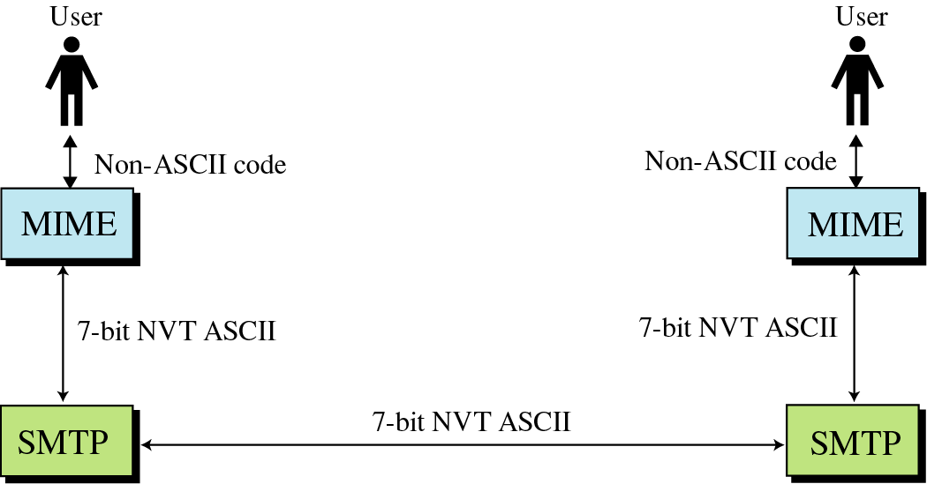
MIME

Slide 80
MIME
Defines five additional headers
  MIME-version
    MIME-Version: 1.1
  Content-Type
    Type of the data used in the body
    Content-Type: <type/subtype; parameters>
    Subtype
      Text, Message, Image, Video, Audio etc
  Content-Transfer-Encoding
    Encoding to be used
    Content-Transfer-Encoding: <type>
    Type
      7bit, 8bit, binary, Base64 etc.
  Content-Id
  Content-Description

Slide 81
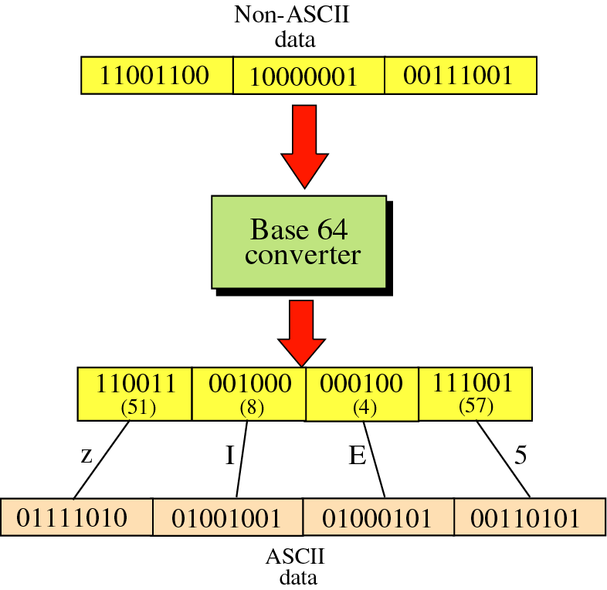
Figure 22-20
Base64

Slide 82
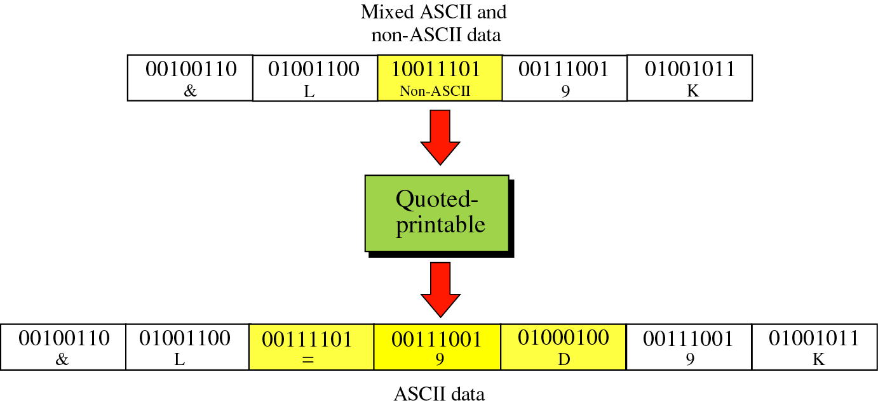
Figure 22-21
Quoted-printable

Slide 83
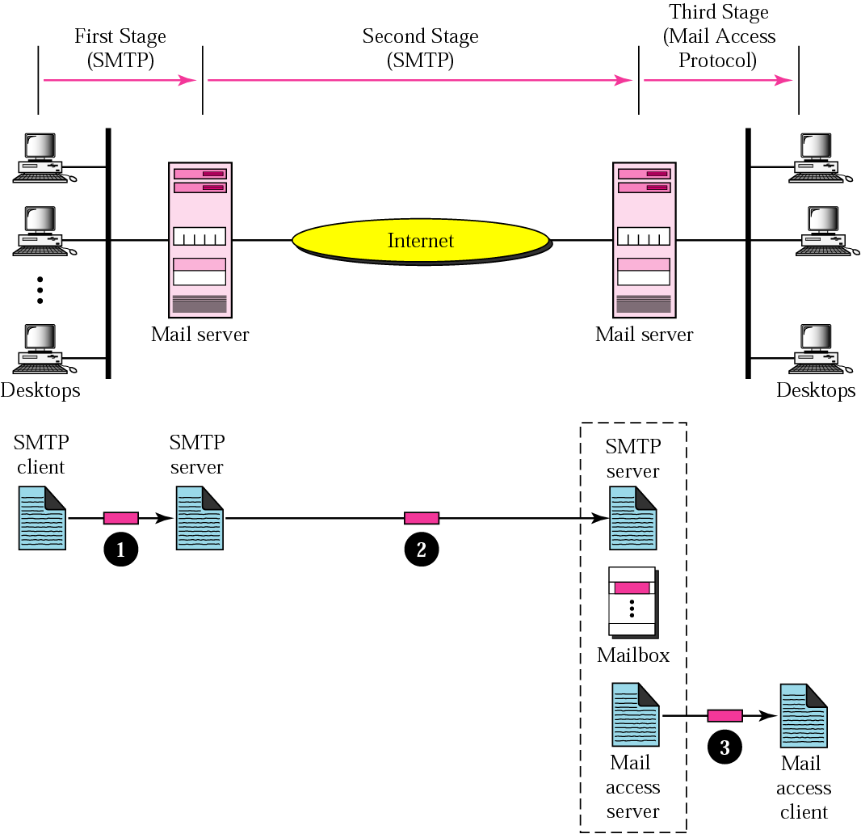
Mail Delivery

Slide 84
HyperText Markup Language (HTML)

Slide 85
Introduction
Standardized by World Wide Web Consortium (W3C)
Used to encode WWW documents (web pages)
Document-layout and hyperlink specification language
Defines the syntax and placement of various media like text, images etc. to be displayed by the browser
Marking up means additions of certain commands (in the form of tags) to our document in order to tell the browser how we want the document displayed

Slide 86
First HTML page
<html>
<head>
<title>My First html page</title>
</head>
<body>
Hello World!
</body>
</html>

